Slide 1

For and While Loops
You expected Dylan to make this presentation, but it was actually I, DIO!
By Dylan Martin

Slide 2
Overview
This presentation will cover:
The different types of for and while loops.
The proper syntax for each one.
The difference between ‘for’ and ‘while’.
The application of for and while loops to your everyday programming needs.

Slide 3

For Loop
A basic for loop consists of the following parts:
for()
Iterator variable
End condition
i++ (or variable increment)
Code Block

Slide 4

for Loop Applications
For loops are used so that you do not need to repeatedly type out multiple lines of code. It runs only as many times as the iterator is allowed to increase.
Typing out multiple lines of the same code is an inefficient method, and takes up way too much extra time.
I shall show you an example of my project that I’ve been working on.

Slide 5
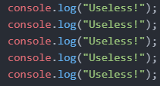


for Loop example
Using a for loop is much more efficient than typing this out multiple times.
Writing more than you need to is useless.

Slide 6
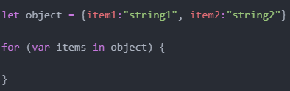
for in Loops
For in loops consist of the following parts:
for()
Variable Identifier
in
Pre-existing object name
Code Block

Slide 7

for in Loop Applications
For in loops are used to loop through arrays and objects, which iterates over property names.
They are commonly used to interact with the content inside the targeted object.
Joseph messed up my code, so I had to make some changes to my project. I will show you.

Slide 8
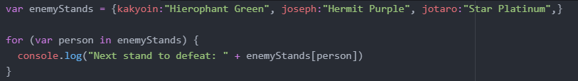


for in Loop example
I made this list, so I could keep track of the stands that The World will surely defeat.
But DIO, You lost…

Slide 9

for of Loops
For of loops consist of the following parts:
for()
variable name
of
Any JavaScript object that can be iterated.
Codeblock

Slide 10

for of Loop Applications
For of functions the same way that for in works, except it iterates only through arrays, maps, sets, and argument objects.
For of loops through property values.
I caught Joseph messing around with my computer again. But I, DIO have fixed and improved my code.

Slide 11
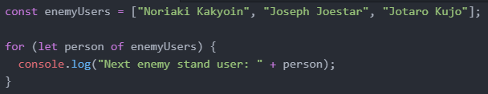



for of Loop example
I’ve updated the list to show that I, DIO are superior to the both the stand and user!
DIO? Are you just ignoring me?

Slide 12

.forEach() Loops
.forEach() has a different syntax compared to the other loops, due to it being a built-in function. It’s syntax consists of:
Variable
.forEach()
Arguments
Code Block

Slide 13

.forEach() Loops Applications
.forEach loops through the number of values inside of an array, rather than what each value is equal to.
A separate function is required to run the loop.
I made some extra changes to my code.

Slide 14
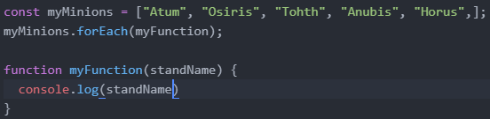

.forEach() Loops Example
I decided keeping a list of my minions is equally as important.

Slide 15

while and doWhile Loops
while loops run constantly as long as the condition given is not false. The syntax is as follows:
while
Condition
Codeblock

Slide 16
while and doWhile Loops continued
doWhile loops are similar to while, except the codeblock comes first.
do
Codeblock
while
Condition

Slide 17
while and doWhile Loops Applications
while loops can be iterated to make it loop a fixed number of times, just like for loops.
It iterates until the condition is met, rather than a preset number, allowing for easier infinite loops.

Slide 18

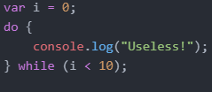
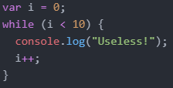

While Loops Example
I made a few changes to my beginning code.
There is more than one way to do it.

Slide 19
For and While: What’s the difference?
While loops until a condition is met, for happens a preset number of times.
While is used when the number of iterations you want to loop is unknown or infinite, for is better if you know exactly how many times you want to loop.
When iterating a while loop, you need to declare the iterator outside the loop, whereas for loops allow you to declare it in the loop.

Slide 20
Any questions?
Also be sure to fill out the Lesson Notes for this week.

